Slide 1



Introduction To Linux Kernel Development Session 8
Part 8: Linux Device, Driver & Bus Model
Dexuan Cui, Steven French, K Y Srinivasan

Slide 2
Instructors
Dexuan Cui
Steven French
K Y Srinivasan

Slide 3
Instructor
Dexuan Cui
- Worked on Xen during 2006~2014 at Intel, mainly on enabling VT-x (VMX).
- Have been working at LSG on the Linux/FreeBSD Hyper-V drivers since then.
Worked on the FreeBSD Hyper-V drivers: enhanced the disk/network performance, ported the vPCI driver.
Implemented the Linux Hyper-V Sockets driver; implemented the suspend/resume ops for Linux VMBus state for Linux VM hibernation; co-maintain Hyper-V/Azure Core Drivers.
Implemented and maintain the Linux MANA VF NIC driver (drivers/net/ethernet/microsoft/mana/) with Haiyang Zhang.
Working on the Linux CVM kernel support (AMD SEV-SNP and Intel TDX).

Slide 4
Instructor
Steven French
- Original author, and maintainer of the Linux SMB3 network filesystem client (cifs.ko), one of the more active Linux filesystems, and also co-maintainer of the new kernel server (ksmbd).
Member of the Samba team (and original author of the 'net' utility)
Work in the Azure Files team
Formerly was File Systems Architect at the IBM Linux Technology Center
Rice University (Bachelors CS, Masters Computer Engineering)

Slide 5
Course Coordinator - Dr. K Y Srinivasan
• Distinguished Engineer - Microsoft Corporation
Original author of most of the Linux enlightenments for Hyper-V
Founded LSG
• Distinguished Engineer - Novell Inc.
• Chief Architect Of the Next Generation 64-bit NetWare platform – Modesto
• Developed the infrastructure to run Enlightened Windows on the Xen Hypervisor
• Distinguished Engineer - AT&T Bell Laboratories
• Chief Architect of the System V multiprocessing Release
• Developed the first fully preemptible Unix Kernel
• Active innovator in the areas of Virtualization & Operating Systems
•https://scholar.google.com/citations?user=fTMnNPsAAAAJ&hl=en
Notes:
Introduce myself as the coordinator
Level of incompetence – Peter
The progress we have made this last decade
What this class and instructors indicate about our progress.
. Feedback etc.

Slide 6
Last week
Answer questions or deal with any spillover from the previous session.
And a few quiz questions:
Can anyone tell us what the difference between “atomic_context” vs. “non-atomic context” is? What about an “interrupt context?”
What is a “jiffie?”
What is the difference between “IDR” and “IDA?"

Slide 7
Linux Device, Driver & Bus Model
Topics Covered:
Linux bus:
struct bus_type
Linux device:
struct device
Linux driver:
struct device_driver
Device discovery, matching and driver loading machinery
Lab:
~/class-projects/week8
1. Evolve the fake device code to conform with Linux device model
2. Evolve the fake bus code to conform with Linux bus model

Slide 8
The Big Picture – Object Heirarcy
Linux Bus/Device/ Driver Core
BUS
Device
Driver

Slide 9
The Linux Core - 1
1. Operates on base data structures:
a. struct device
b. struct bus_type
c. struct device_driver
2. Manages various sysfs objects that are created to surface the bus, device and the driver
a. /sys/bus/
b. /sys/device/
3. Provides the infrastructure to manage the life cycle of the managed objects
4. Helper functions to surface additional attributes in sysfs

Slide 10
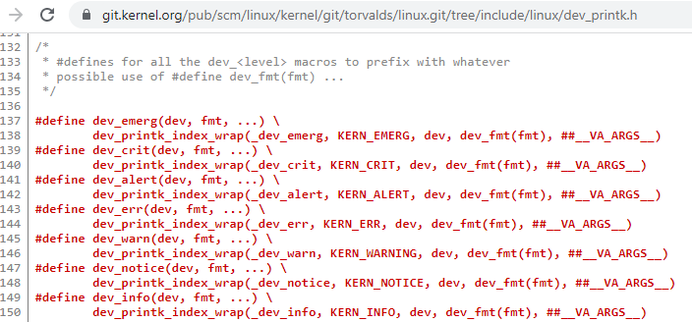
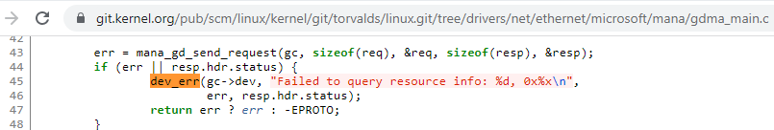
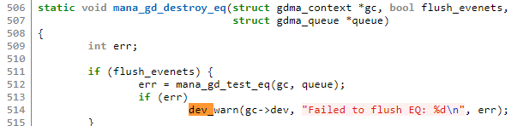
Device drivers have many helper functions
For example Linux drivers have their own print functions

Slide 11
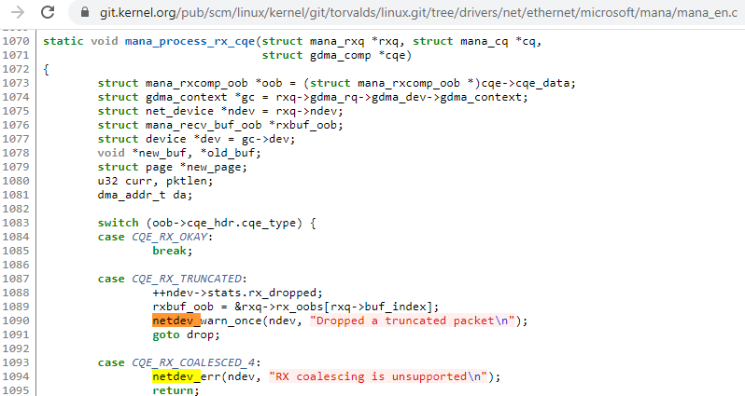
And subsets of drivers (in this case network drivers) often have their own helper functions
For example the mana driver uses various netdev helpers

Slide 12
The Linux Core - 2
A specific bus driver can extend the base data structures by embedding the base data types in bus specific data structures.
The core only initializes fields that are not explicitly set by the specific bus/device driver.

Slide 13
The Linux Core - 3
Supports the following model:
Devices and Drivers are decoupled from a lifecycle management perspective.
Supports dynamic discovery and binding of drivers to devices.
Supports generating udev events to notify user-mode to facilitate auto-loading of relevant drivers in response to device discovery.

Slide 14
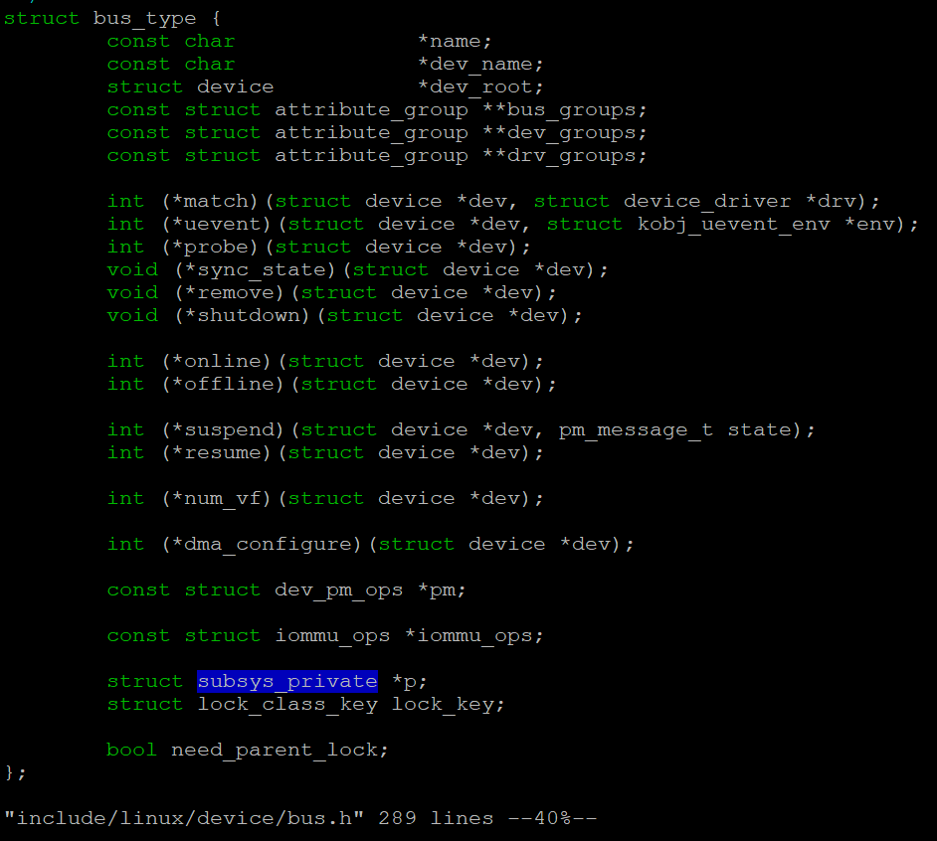
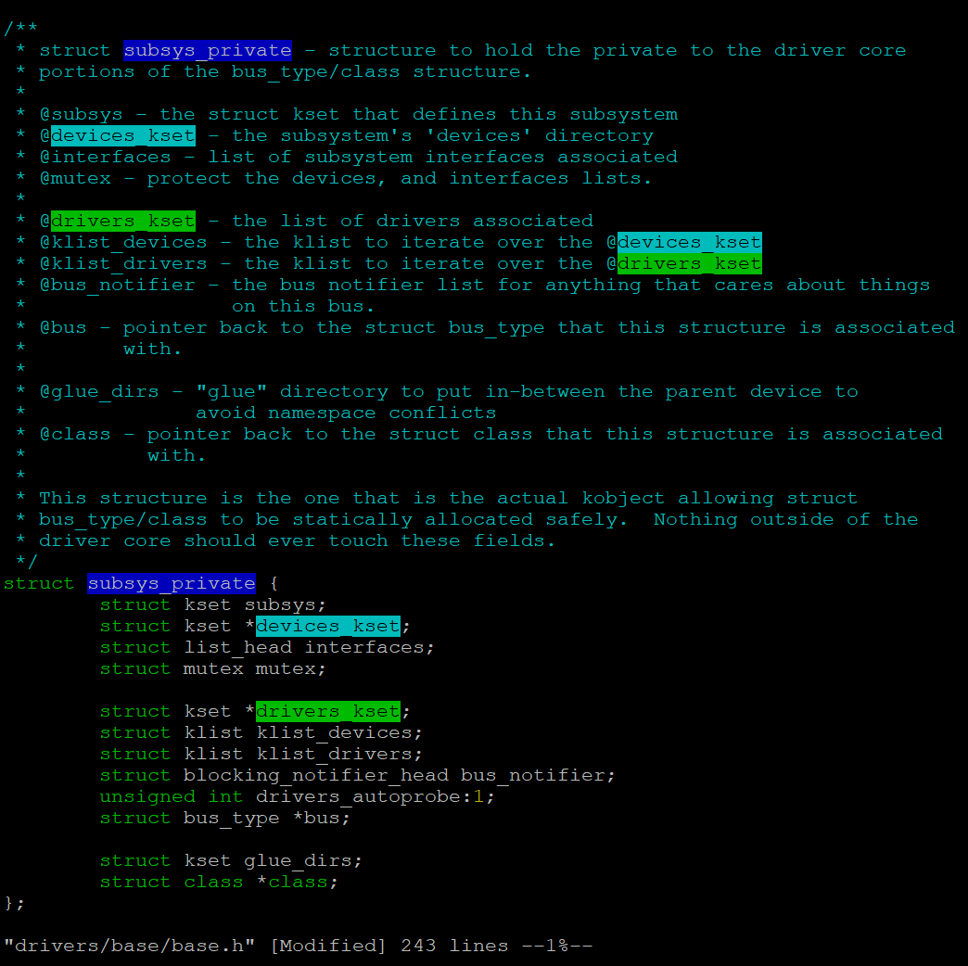
Include/linux/device/bus.h – struct bus_type

Slide 15
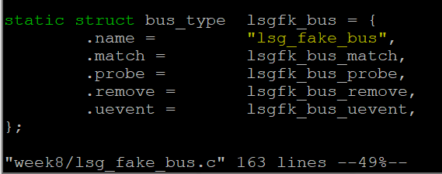
Our Fake Bus

Slide 16
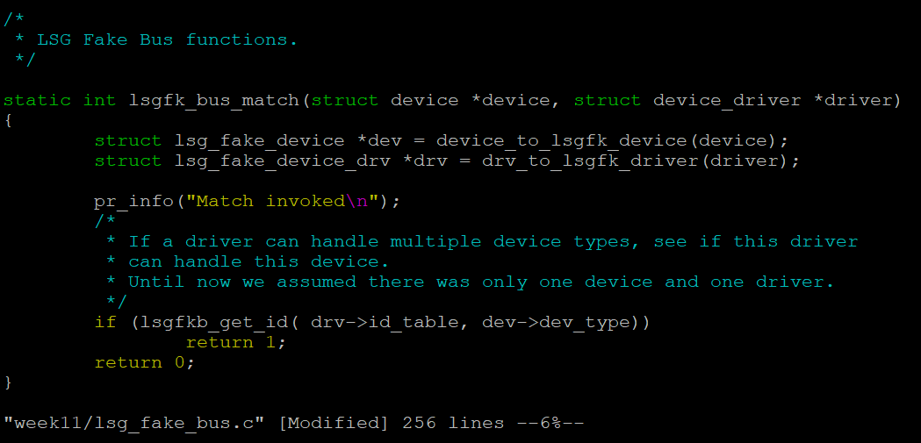
Our Fake Bus - match()

Slide 17
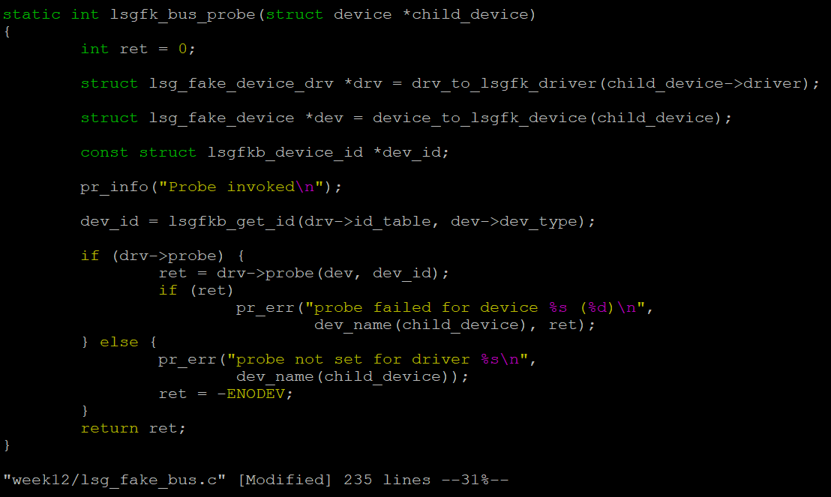
Our Fake Bus - probe()

Slide 18
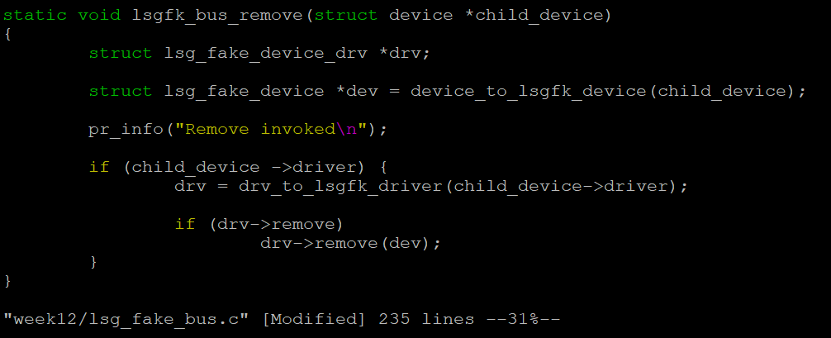
Our Fake Bus - remove()

Slide 19
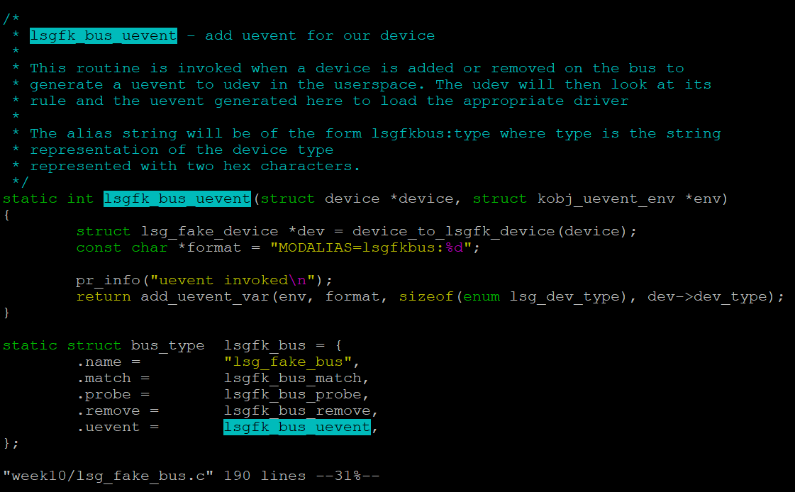
Our Fake Bus - uevent()

Slide 20
Interaction with the core
1. During the bus module initialization:
bus_register(&lsgfk_bus);
2. During the bus module exit operation:
bus_unregister(&lsgfk_bus);

Slide 21
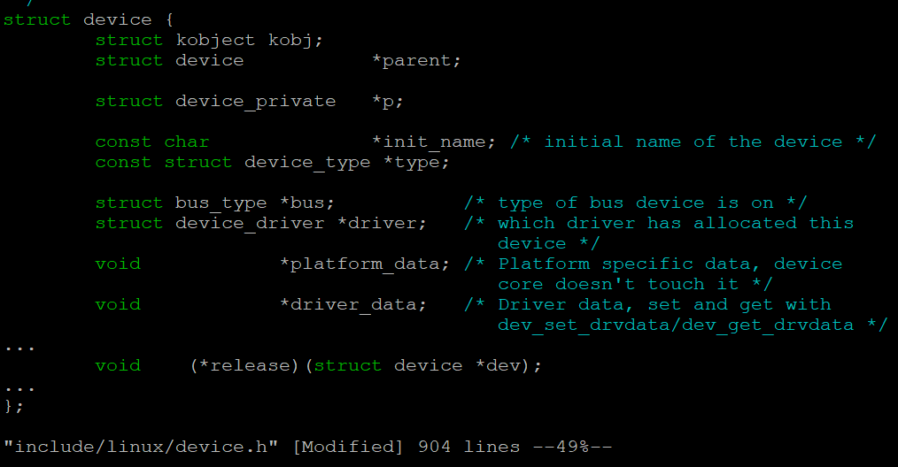
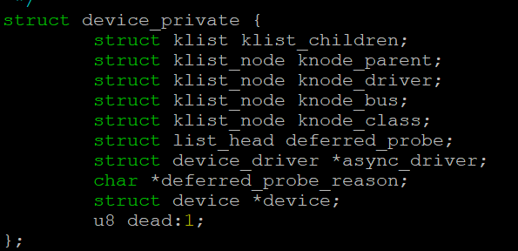
include/linux/device.h – struct device

Slide 22
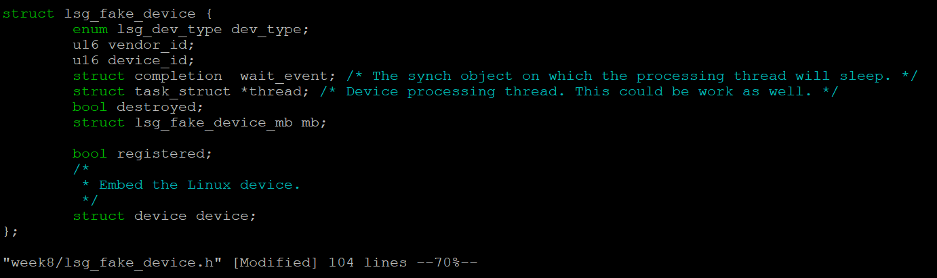
Our Fake device

Slide 23
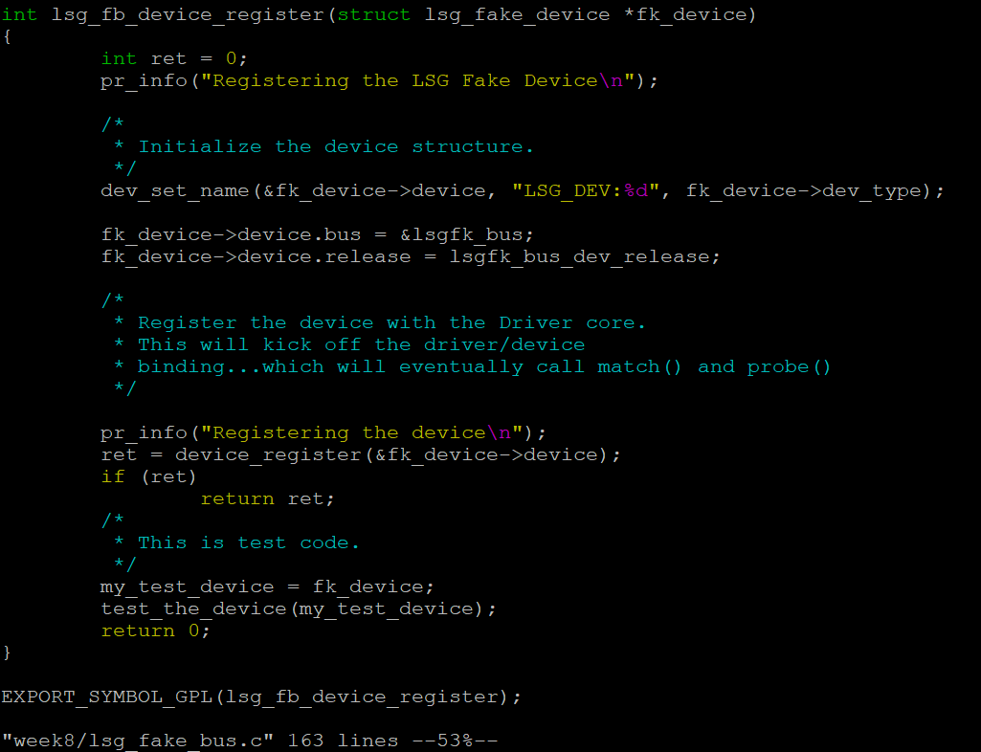
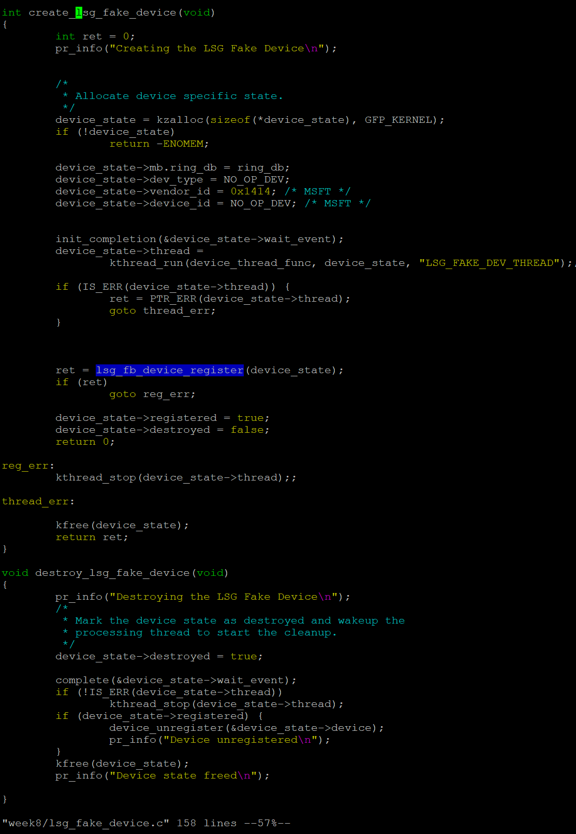
Our Fake Bus – Device Register/Unregister

Slide 24
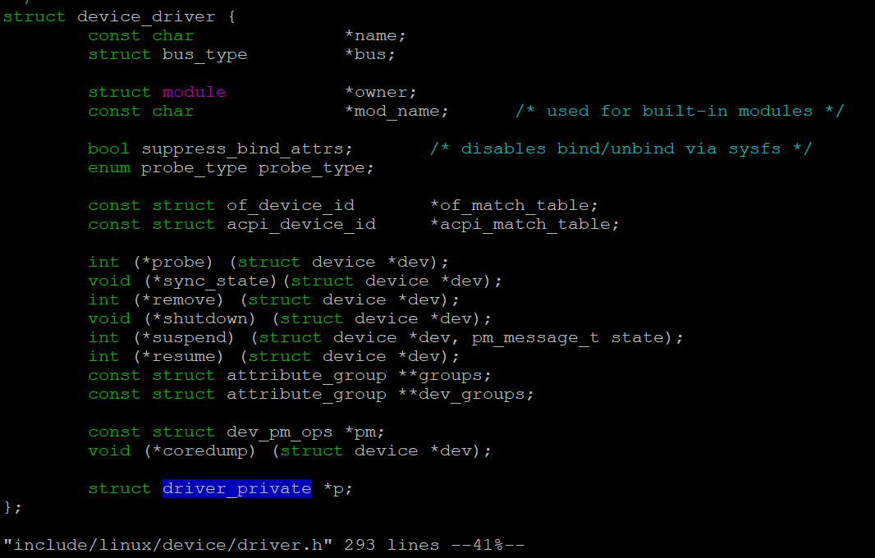
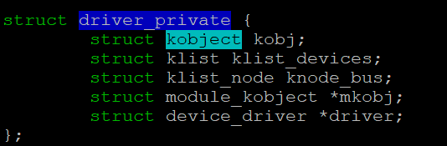
include/linux/device/driver.h – struct device_driver

Slide 25
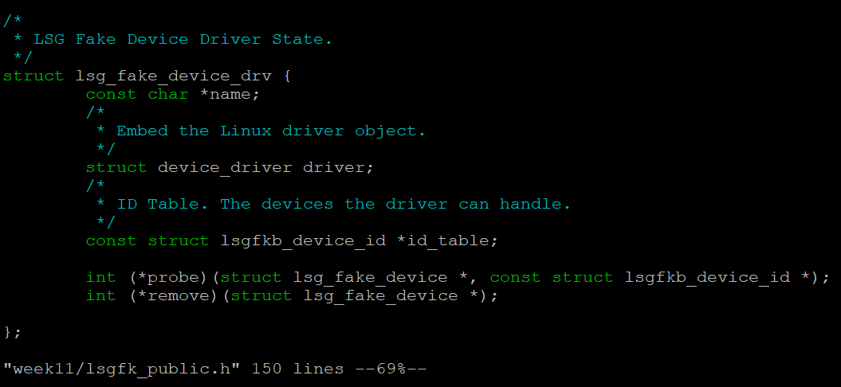
Our Fake Driver

Slide 26
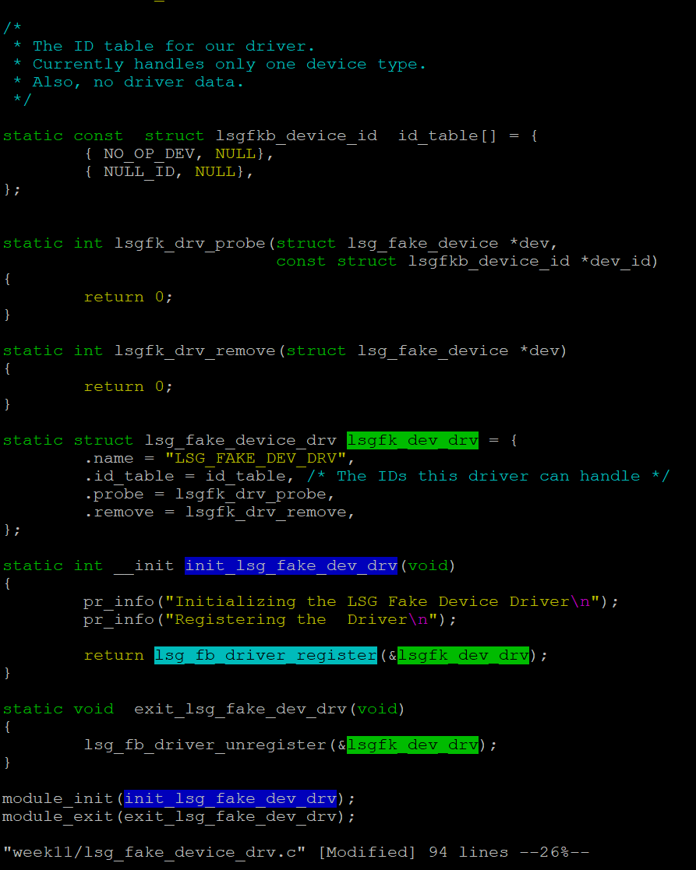
Our Fake Driver (continued)

Slide 27
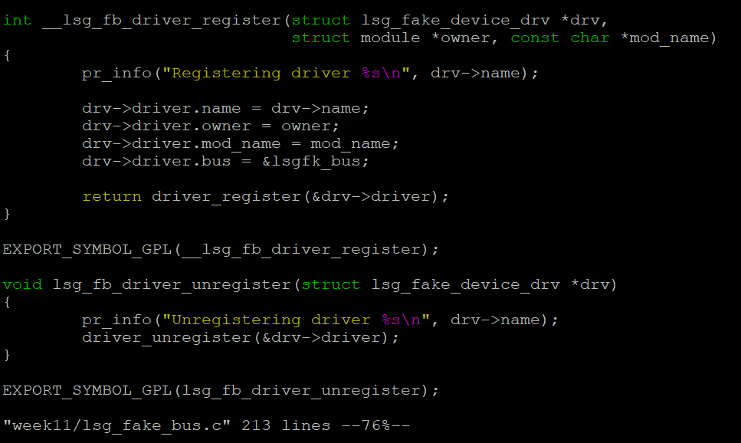
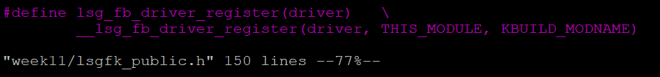
Our Fake Bus – Driver Register/Unregister

Slide 28
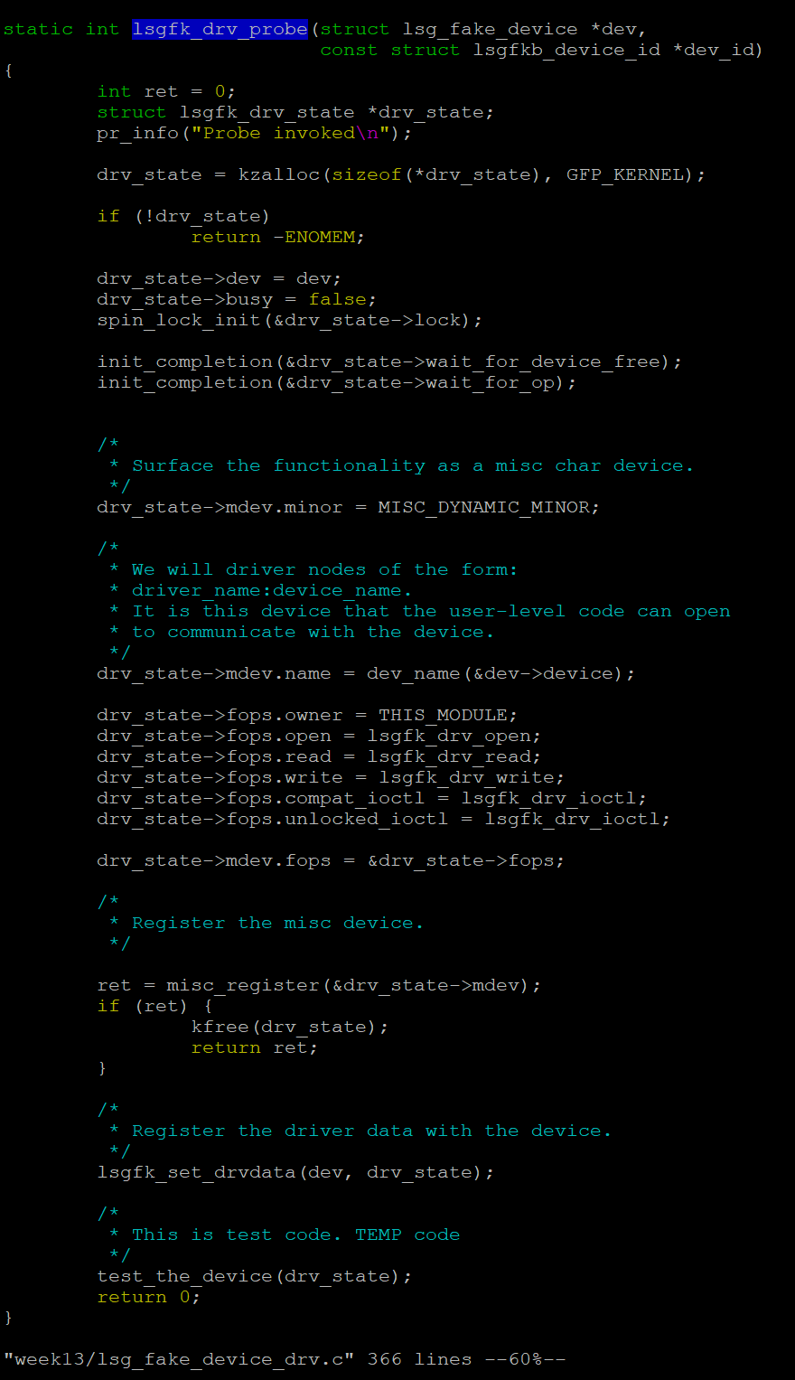
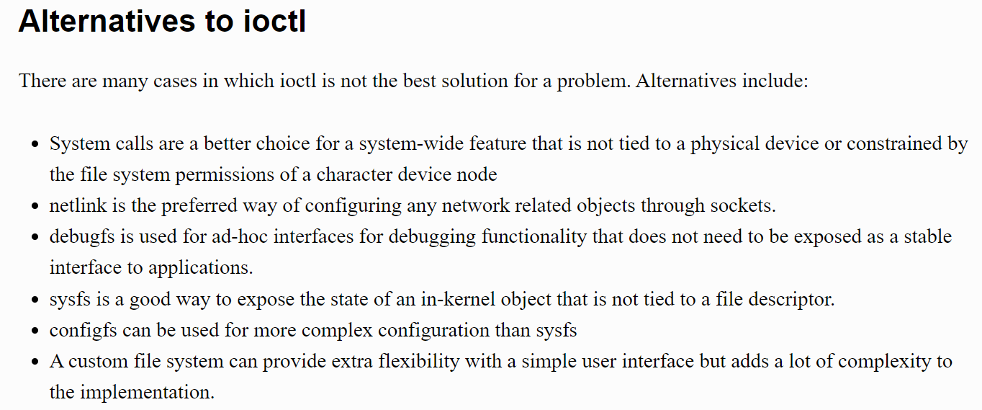
Our Fake Driver - probe()
compat_iotl: support 32-bit user space running on a 64-bit machine.
unlocked_iotl: the “locked” version of ioctl() was removed in 2010.
https://lwn.net/Articles/119652/
compat_ioctl and unlucked_ioctl() can share the same function, if all structures have their members naturally aligned.
https://www.kernel.org/doc/html/latest/driver-api/ioctl.html

Slide 29
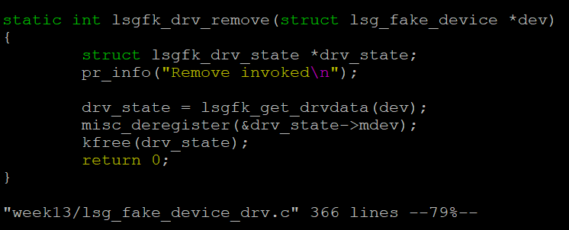
Our Fake Driver - remove()
dev_info(&dev->device, "Remove invoked\n");
It’s better to use dev_*() if a “device” pointer is available, because dev_*() prints the device name.

Slide 30
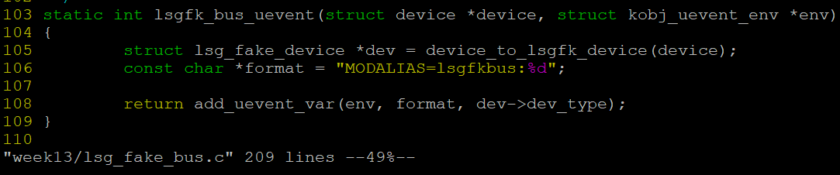
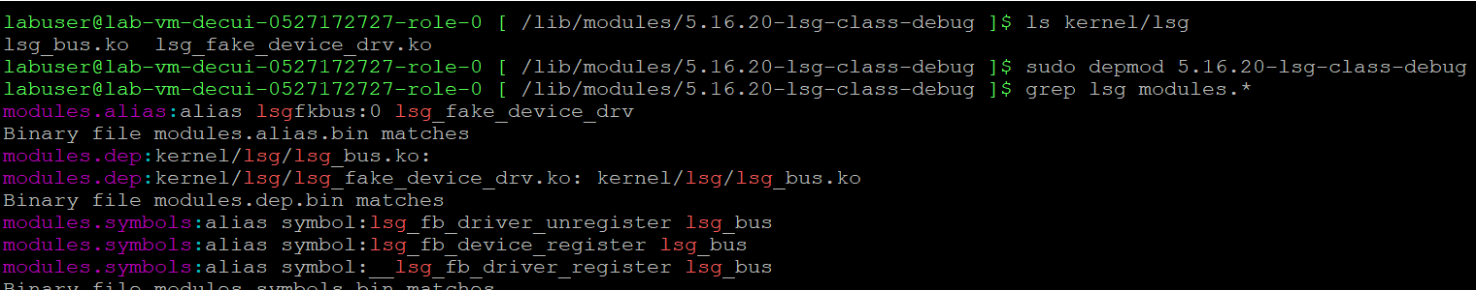
How does device driver auto-loading work?
$ sudo insmod lsg_bus.ko
1. lsgfk_bus sends a udev message when a device is added.
2. systemd-udevd receives the message via socket(AF_NETLINK, SOCK_RAW, NETLINK_KOBJECT_UEVENT);
/usr/sbin/insmod -> /bin/kmod

Slide 31
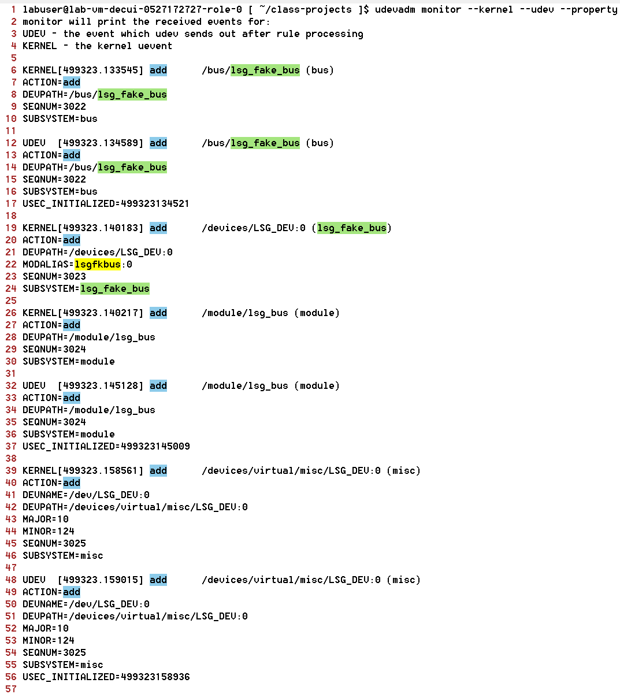
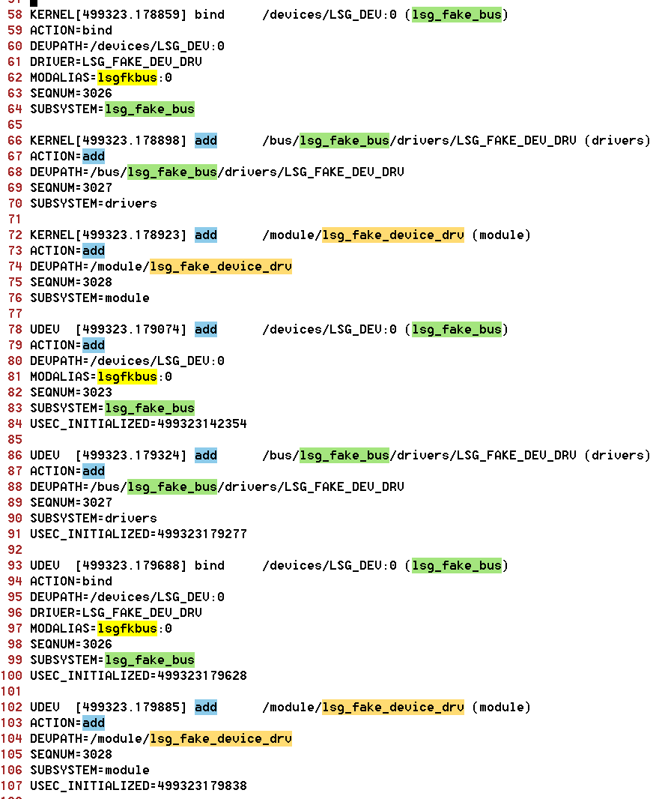
How does device driver auto-loading work? (2)

Slide 32
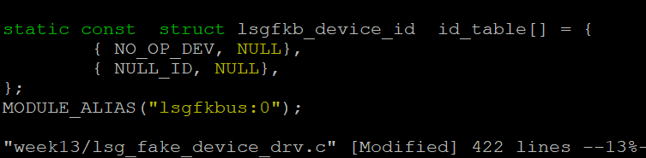
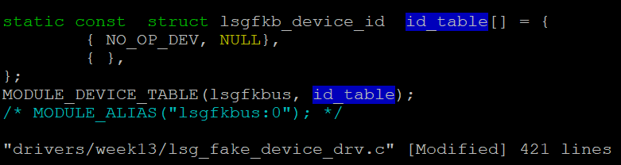
How does device driver auto-loading work? (3)
How does ‘depmod’ generate the file modules.alias?
We add the info manually using MODULE_ALIAS:
Can the info be automatically generated? Yes, for in-tree divers, and some extra work is still required:
Convert the out-of-tree driver to an in-tree driver (copy the code, update Makefile/Kconfig, etc.)
cp -aux ~/class-projects/week13/ ~/linux/drivers/
echo “obj-y += week13” >> ~/linux/drivers/Makefile
The last entry of id_table should be “{}”.
Replace MODULE_ALIAS with MODULE_DEVICE_TABLE.
Update scripts/mod/file2alias.c
cd ~/linux;
wget https://raw.githubusercontent.com/dcui/kernel-examples/master/Week13-in-tree-driver/0001-convert-the-driver-into-an-in-tree-driver.patch
patch –p1 < 0001-convert-the-driver-into-an-in-tree-driver.patch
make -j3 && sudo make modules_install && sudo make install

Slide 33
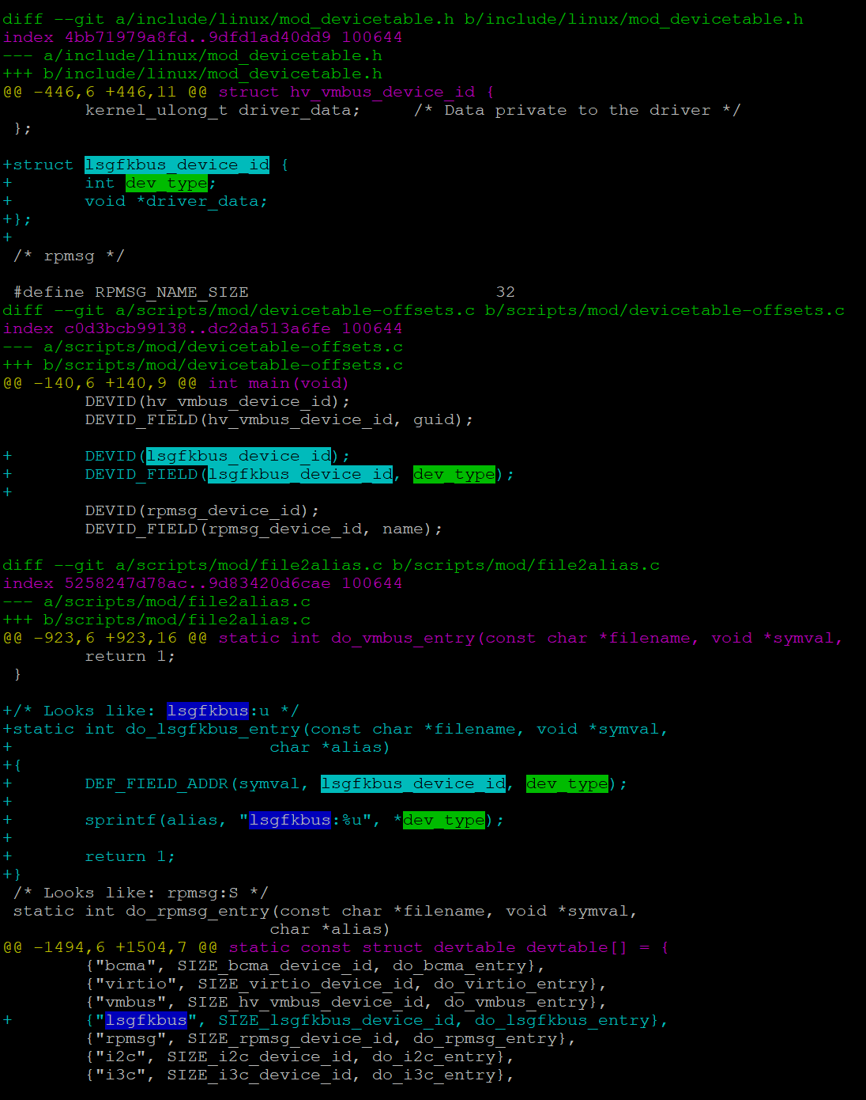
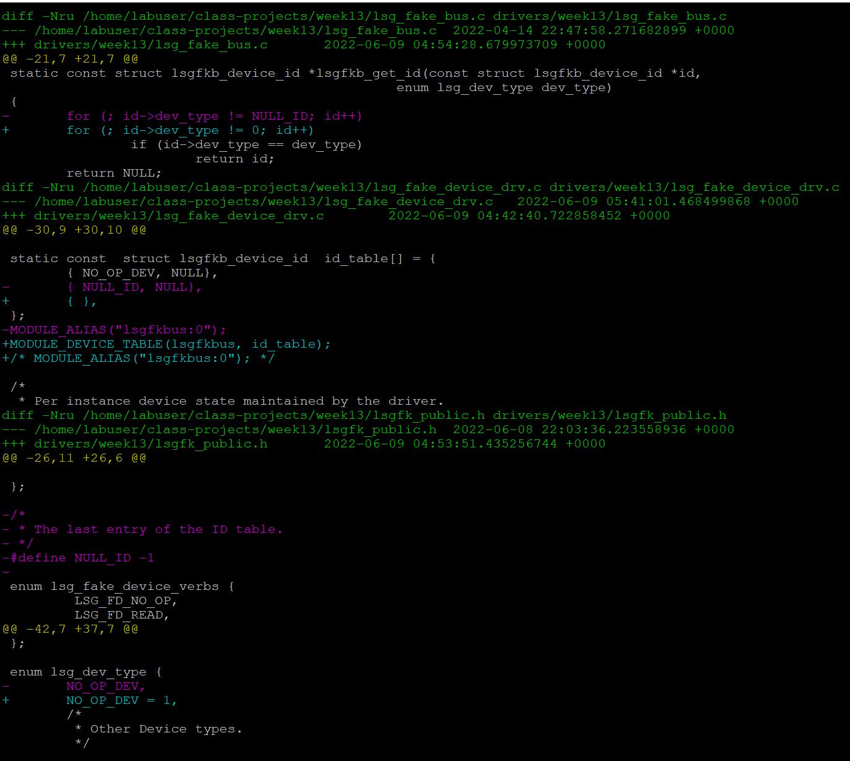
How does device driver auto-loading work? (4)
Update scripts/mod/file2alias.c

Slide 34
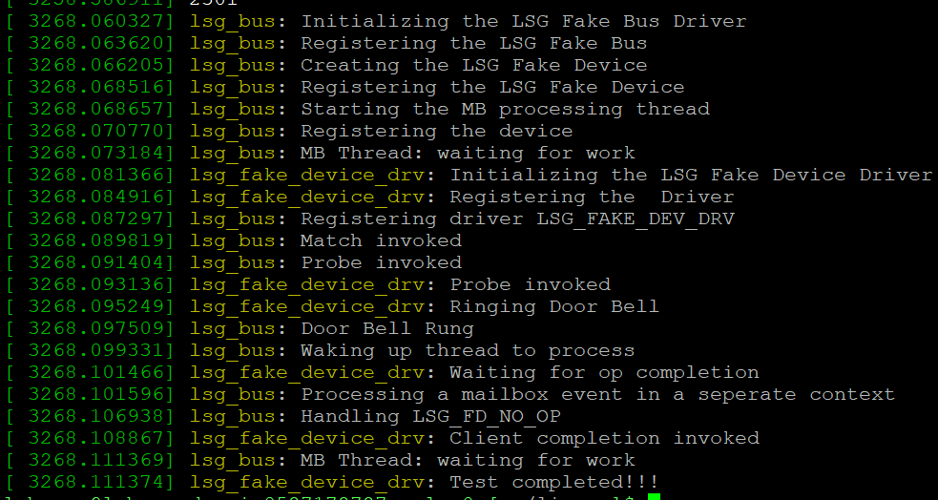
How does device driver auto-loading work? (5)
make -j3 && sudo make modules_install && sudo make install
drivers/week13/lsg_fake_device_drv.mod.c: MODULE_ALIAS("lsgfkbus:1");
/lib/modules/5.16.20-lsg-class-debug+/modules.alias: alias lsgfkbus:1 lsg_fake_device_drv
/lib/modules/5.16.20-lsg-class-debug+/modules.dep:kernel/drivers/week13/lsg_fake_device_drv.ko: kernel/drivers/week13/lsg_bus.ko
/lib/modules/5.16.20-lsg-class-debug+/modules.order:kernel/drivers/week13/lsg_bus.ko
/lib/modules/5.16.20-lsg-class-debug+/modules.order:kernel/drivers/week13/lsg_fake_device_drv.ko
sudo insmod /lib/modules/5.16.20-lsg-class-debug+/kernel/drivers/week13/lsg_bus.ko (or “modprobe lsg_bus)”
← the lsg_fake_device_driver is automatically loaded.

Slide 35
An interesting race condition between device discovery and driver auto-loading
A VM has 4 Hyper-V vNICs (A, B, C, D): usually the interface names are eth0, eth1, eth2 and eth3.
Sometimes the names can be eth0, eth2, eth1, eth3.
The host offers the vNICs to the VM in order, and Linux hv_vmbus detects the vNICs in order.
hv_netvsc already uses PROBE_FORCE_SYNCHRONOUS.
How does this happen?
hv_vmbus driver detects A and B, and just saves them in a list, and no device probing happens.
systemd-udev notices these new devices and starts to load hv_netvsc.
hv_netvsc probes A, and assigns “eth0” to it.
hv_vmbus detects C. Since hv_netvsc is already loaded, hv_vmbus synchronously binds C to hv_netvsc, so C gets “eth1”.
hv_netvsc probes B, and B gets “eth2”.
hv_vmbus detects D, and binds D to hv_netvsc, and D gets “eth3”.
Workaround: CONFIG_HYPERV_NET=y or use other mechanisms to identify the vNICs.

Slide 36
Lab: Analyze how Linux hv_vmbus registers devices and drivers.
drivers/hv/vmbus_drv.c: hv_acpi_init() → vmbus_bus_init() → bus_register(&hv_bus)
drivers/hv/channel_mgmt.c: vmbus_onoffer() → vmbus_process_offer() ➔ vmbus_add_channel_work() → vmbus_device_register() → device_register()
drivers/hv/vmbus_drv.c: __vmbus_driver_register() → driver_register()
drivers/hv/vmbus_drv.c: examine how vmbus_dev_groups, vmbus_drv_groups and vmbus_bus_groups expose the related info via sysfs.

Slide 37
Thank You!
Q & A

Slide 38
Next Week
Part 9: Observability & Tracing
Please complete the lab work ~/class-projects/week8.
(Please also check ~/class-projects/week11 for driver registration, and ~/class-projects/week13 for character device)
Please provide feedback: https://aka.ms/AzureAdvanced/feedback

